Slide 1
Food Searching For Winter
CMPT 276 Group 15
Clinton Weng, Jackson Yuan, Joanna Li, Linda Li

Slide 2

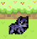

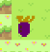

Key Points About the Project
Winter is getting close, and the player is here to help the bunny to stock up carrots for the winter! Avoid all the wolves!
A* searching algorithm is implemented as the pathfinding for the wolves.
Some awards have fixed locations, and some can randomly spawn! Keep your eyes on them!
You have to help the bunny collect all the carrots so it can live through the winter. Be careful for the spoiled carrots!

Slide 3
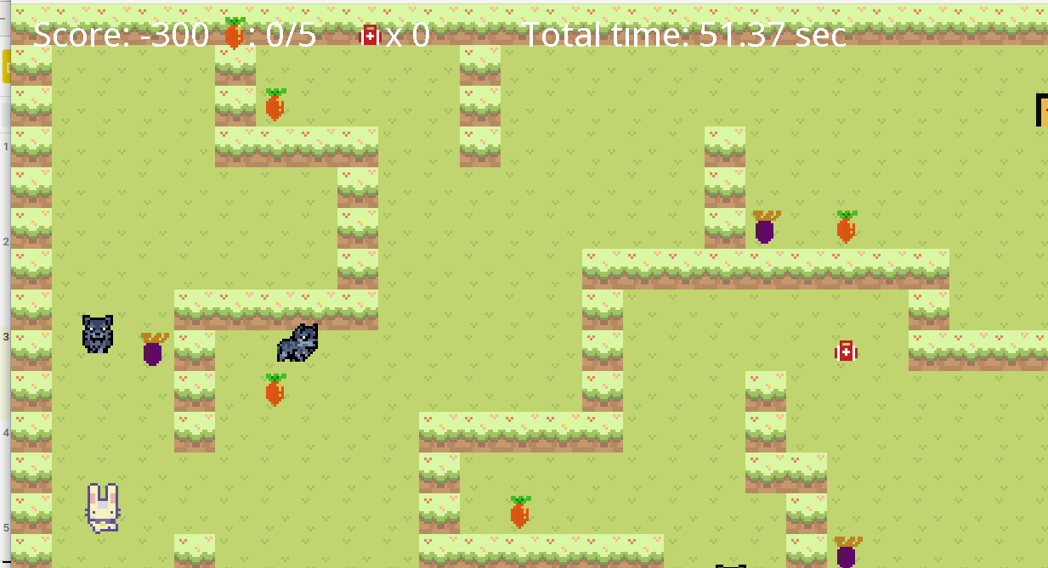
Game Panel

Slide 4
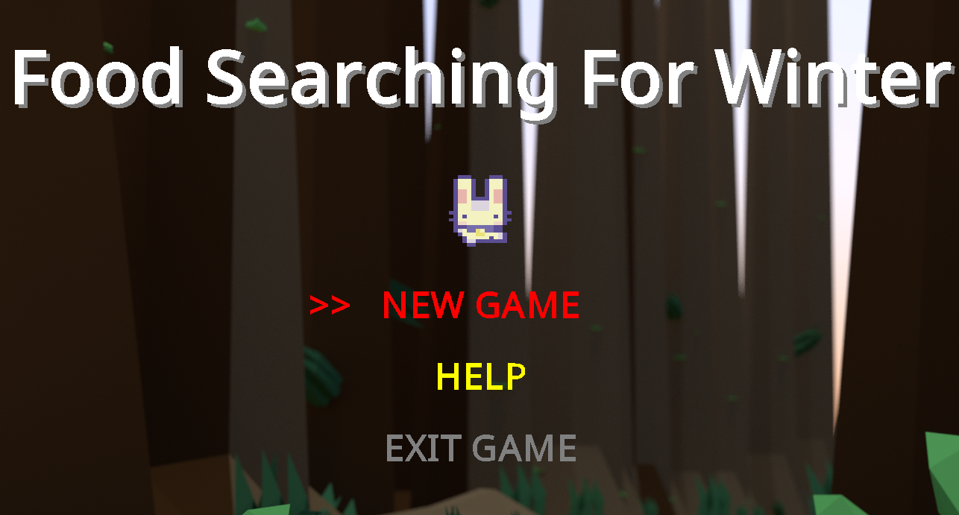
Main Menu

Slide 5
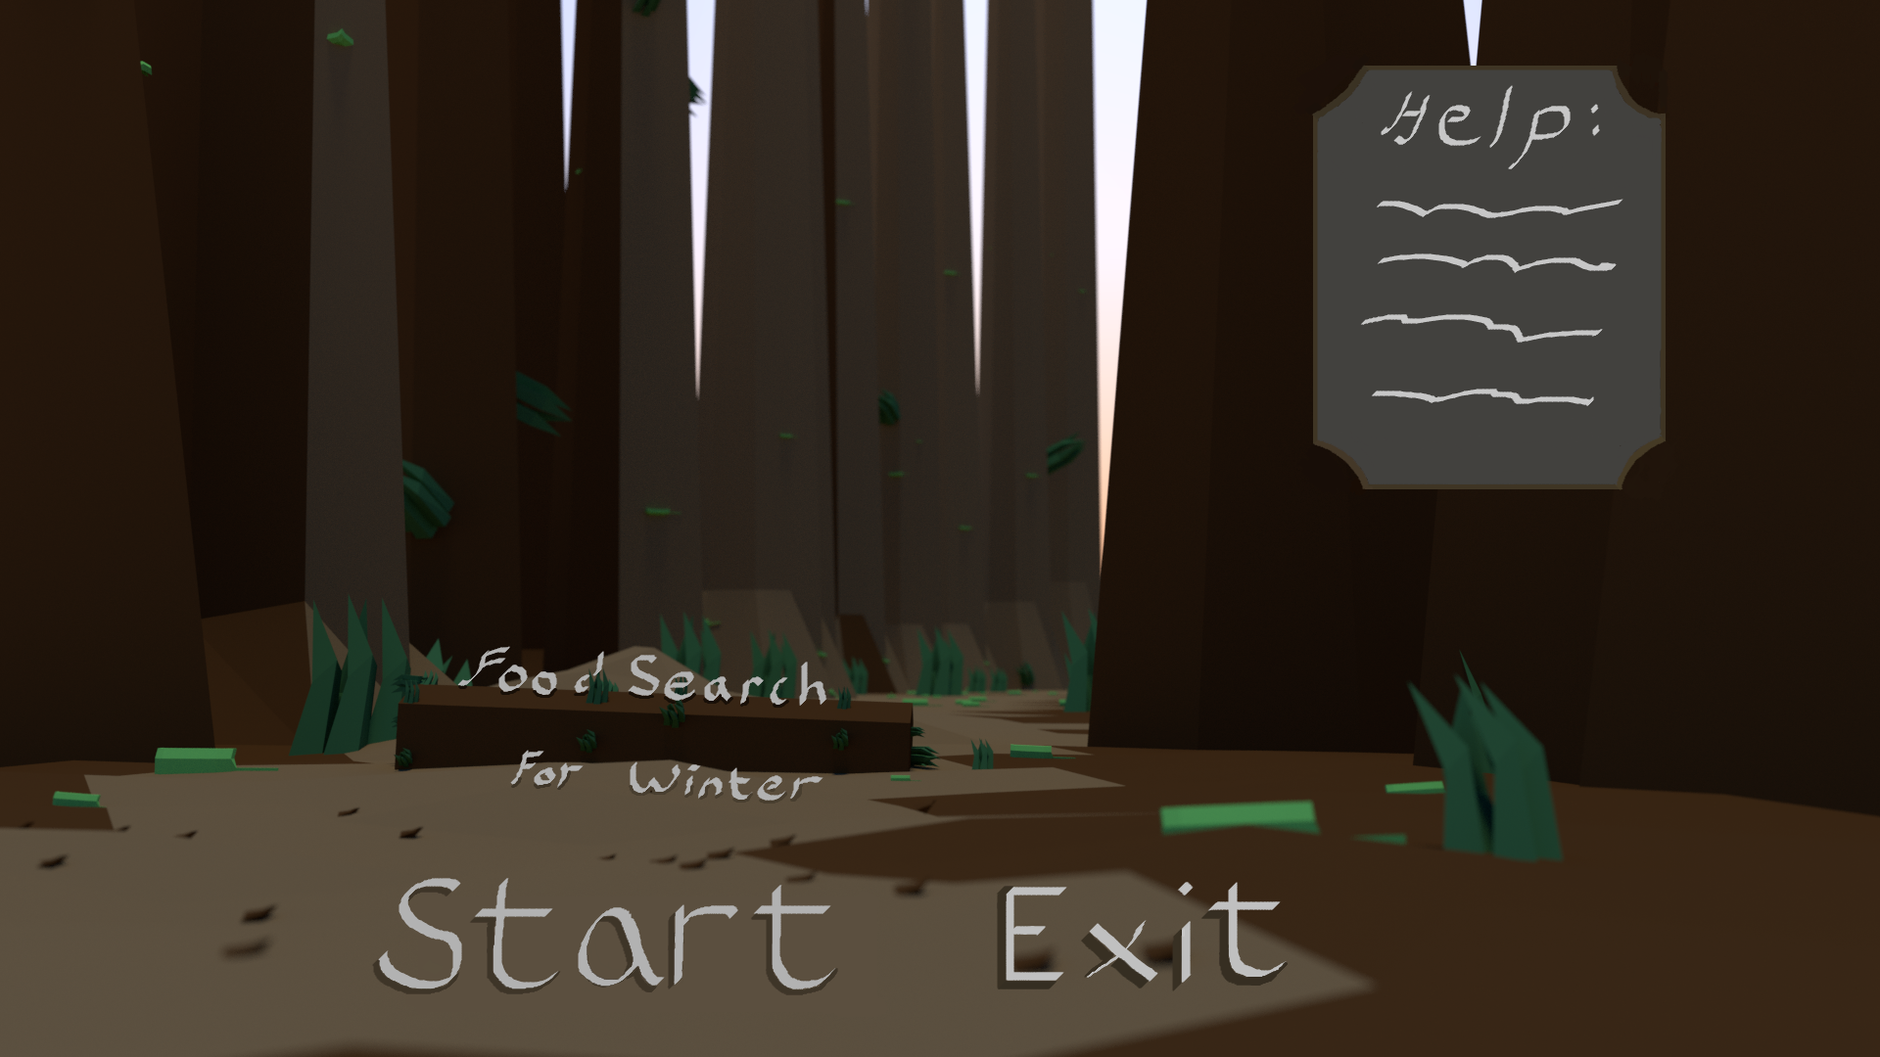
Changes from initial design
Original menu design
The original menu design was a bit hard to read

Slide 6

Play Game

Slide 7

Testing
-Doing all tests using the JUnit framework
-Unit Testing: test signal feature at a time
Test methods in the class using assertions
E.g., reward placements, position initializations
-Integration Testing: test interactions between components
E.g., collision between players and objects, UI
-Improved the some classes along with testing

Slide 8
Project and Team Management
Group Chat via Discord; meeting with zoom
Discuss plans & ideas,
Notify each other when pushing to git
Divide the work between group members
E.g., who’s responsible for implementing rewards, player , enemies…
Cooperate when there’s uncertainty
Time management
Make sure to finish what we have planned for this week

Slide 9
Biggest Challenges and Lessons Learned
Understanding how everything is linked together as a whole system can be challenging at the beginning.
Difficulty estimating time and resources when the semester comes near the end.
Coming up with a well-structured architecture is not easy, it requires a lot of efforts in learning the requirements and how things integrate together.
Troubleshooting for the system and spot the bug can be very difficult. Using the debugger for troubleshooting is very useful!
Only change one thing at a time and verify that the function you just implemented is working.
Start something small then extend.

Slide 10
Thank you
Let’s hope that the bunny can live through the winter

